Slide 1
Conclusion

Slide 2
To sum it up:
2000 residents for at least 10 years considered population growth.
Temperature 4~31℃in year
Size,shape,material of tank
Sensor location
Size of orifice
CD,Qin,Qout
Pump Qin, WS, Power
Pipe diameter, length
Max Cp,lambda, angle
Radius of blade

Slide 3
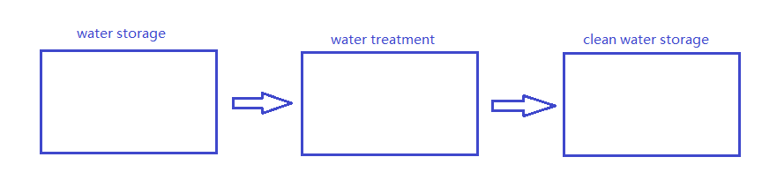
Further consideration
60-days-amount
Our planned three tank for whole system

Slide 4
Will the clean water go bad?

Slide 5
Will the clean water go bad?
Of couse Yes!!!

Slide 6
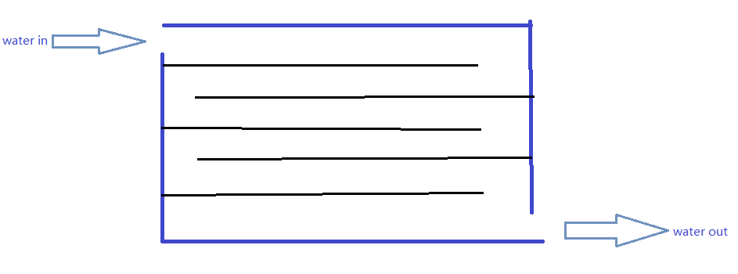
How to solve this problem?
This is our ideal designed inner structure for the clean water storage tank.

Slide 7
Why doing this?
Add some plastic plates in the tank like this.

